Slide 1

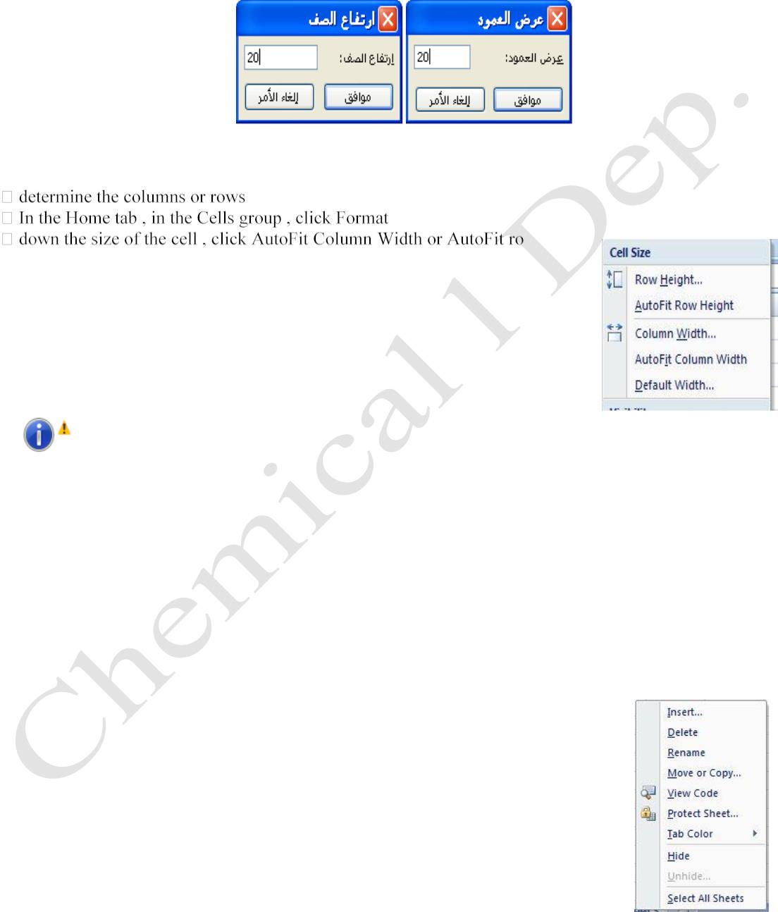
Lecturer
Omar A. Imran
2019 - 2020
Microsoft office Excel 2007
Diyala university/College of Engineering
Department of Chemical Engineering
•
width of the column in the box or display box row, type the value that you want, as in the figure
below.
AutoFit
Can be formatted column or row so sought largest cell in it, and work , and so , follow these steps
w height
is determined by the size of each column or row , including its content is as in
Fig.
Trail Version
Trail Version
Trail Version
Trail Version
Trail Version
Trail Version
Trail Version
Trail Version
Trail Version
Trail Version
Trail Version
Trail Version
Trail Version
Hint: - If you receive half of the text or the form of lines the inside of the cell in this form (#
# # # # ) This means : the existence of a certain value or text , but the cell size does not allow her
appearance in full , and so is the expansion of the cell as previously or by clicking on the dividing line
between columns double pressure .
Dealing with paper
We can deal with worksheets several operations
• Insert Worksheet
Excel file consists of three worksheet can add or delete worksheets to Excel file and add a worksheet
bricks follow one of the following : -
First: - and so by pressing Right on the worksheet and then choose Insert from the
shortcut menu as the form and then pop up a window and choose a worksheet.
First Class
11

Slide 2
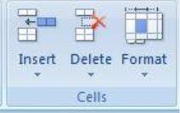
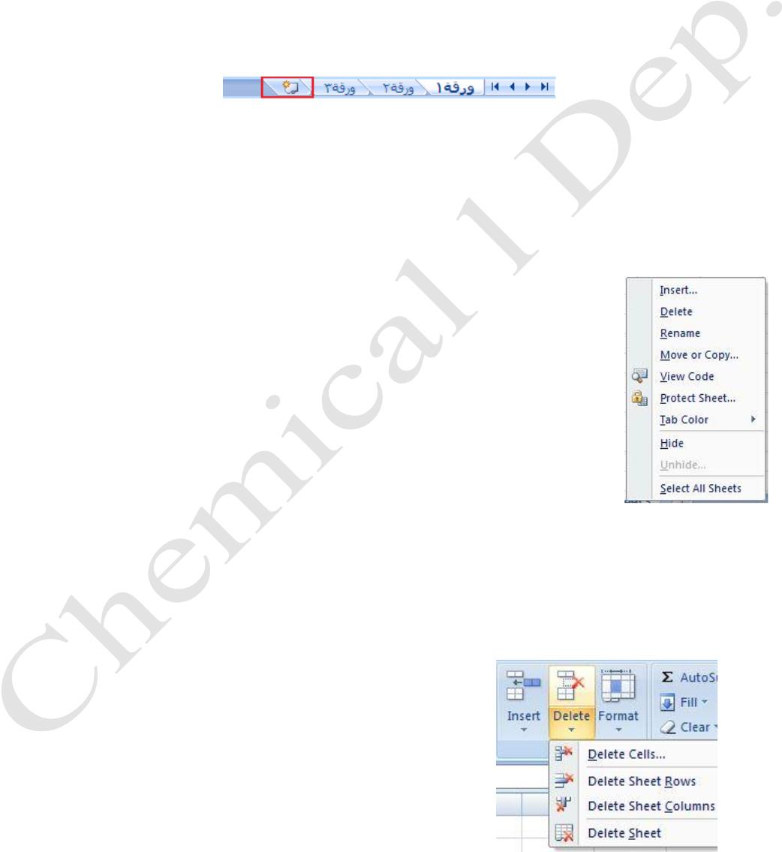
Lecturer
Omar A. Imran
2019 - 2020
Microsoft office Excel 2007
Diyala university/College of Engineering
Department of Chemical Engineering
Second: - In the Home tab , in the Cells group , click the arrow next to Insert, and then click Insert
paper . As in Fig .
Third: - To insert a new worksheet at the end of worksheets found quickly , click the Insert tab and
worksheet bottom of the screen . As in the figure below .
• Delete the paper work
To delete a worksheet, follow one of bricks following : -
First: -
1. identify and paper work that we want to delete
2. pressure Right- paper
Trail Version
Trail Version
Trail Version
Trail Version
Trail Version
Trail Version
Trail Version
Trail Version
Trail Version
Trail Version
Trail Version
Trail Version
Trail Version
3. If I choose to delete the worksheet contains data when the piece
will show a small dialog box that warns us of the data in the
worksheet will be deleted and we will either confirm or cancel
the deletion process. And you should pay attention to that event
will become final and cannot be undone as in Fig .
Second: -
1. identify and paper work that we want to delete
2. In the Home tab , in the Cells group , click the arrow next to delete , then click Delete Sheet .
As in Fig .
First Class
12

Slide 3
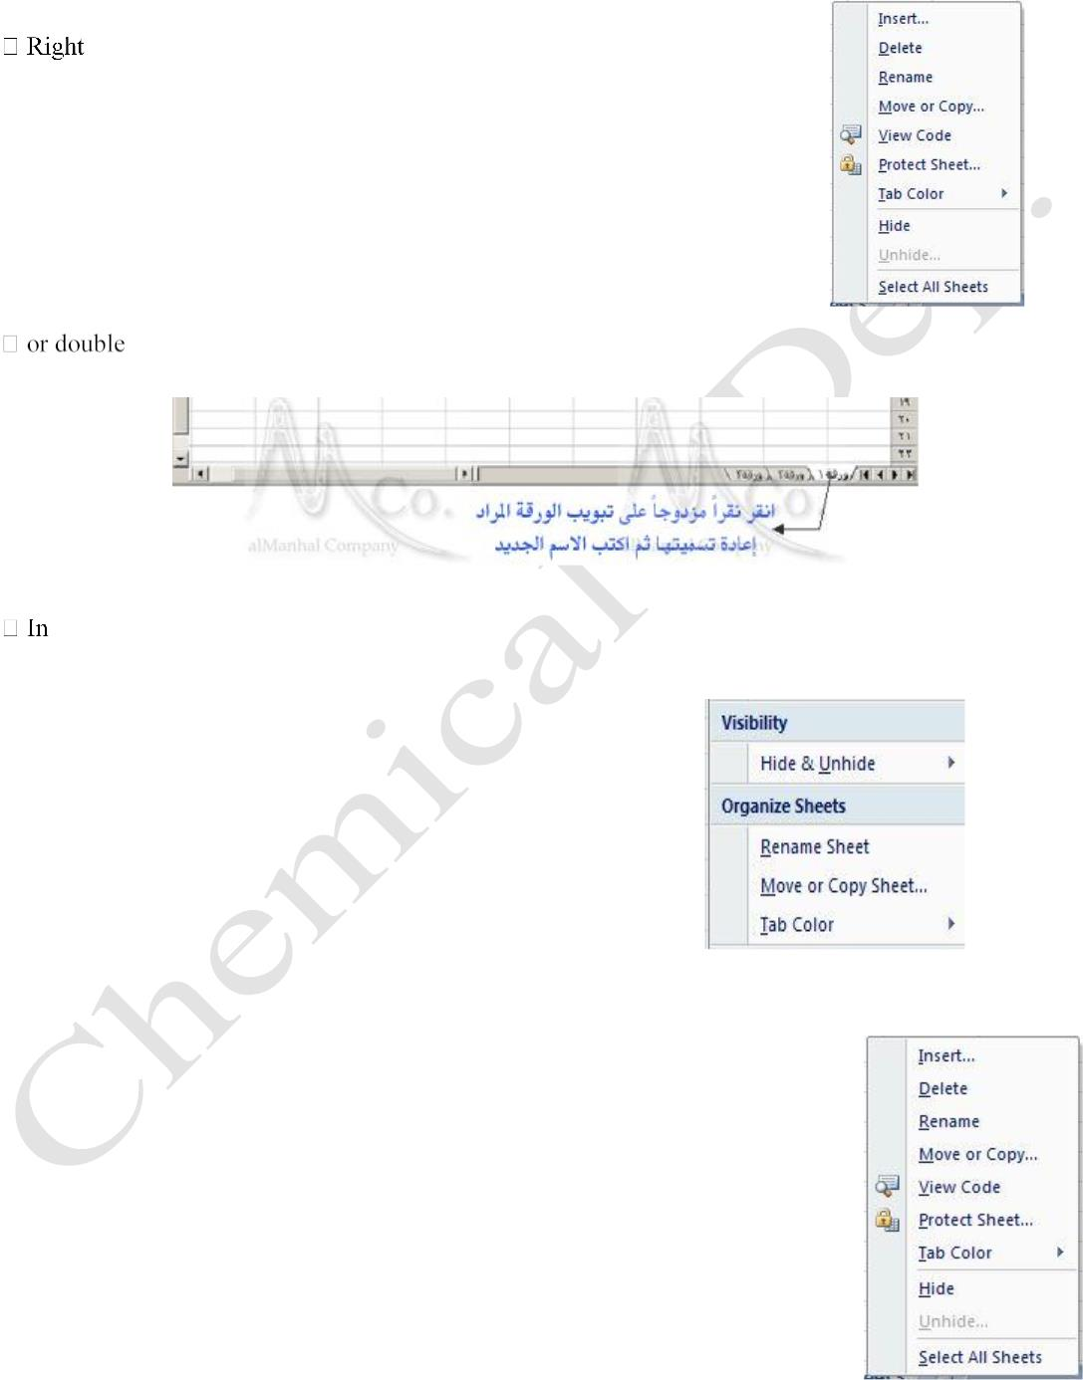
Lecturer
Omar A. Imran
2019 - 2020
Microsoft office Excel 2007
Diyala university/College of Engineering
Department of Chemical Engineering
•
Rename
You can rename the worksheets through one of the following methods: -
First: -
-click on the worksheet and choose Rename as in the figure below.
Second: -
-click on the sheet tab you want to rename, then type the name of the worksheet fits their
content as in the figure below
Trail Version
Trail Version
Trail Version
Trail Version
Trail Version
Trail Version
Trail Version
Trail Version
Trail Version
Trail Version
Trail Version
Trail Version
Third: -
Trail Version
the Home tab, in the Cells group, click the arrow next to the formats, then click Organize paper,
and then click Rename. As in the figure below.
Select All Sheets
And is used when we need to enter data into the stock all at one time , where we
write the values required to be introduced to all the paperwork and work for it ' by
one of the following steps : -
1. Right- click on the worksheet and choose Select All Sheets . As in Fig .
2. can also pressing the shift key with a click of the mouse on the name of
the first sheet and then the last .
3. or using ctrl key with a click on the name of each paper .
First Class
13

Slide 4

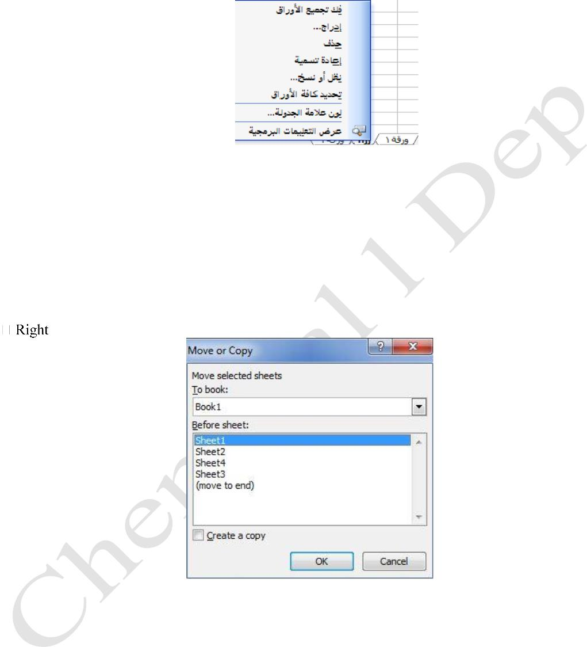
Lecturer
Omar A. Imran
2019 - 2020
Microsoft office Excel 2007
Diyala university/College of Engineering
Department of Chemical Engineering
Hint: -
to cancel the command to select all sheets in a workbook that ,
click any sheet unspecified . Clicking or right-click a sheet tab specific . And click ungroup securities
in the list below in Figure Almokhtsrh.kma
1. Command ( the transfer paper or copied ) : -
Which we can move or copy a worksheet to a new workbook without deleting the original and that's
when we need their data to be absolute and that the followers of one of the following steps : -
Trail Version
Trail Version
Trail Version
Trail Version
Trail Version
Trail Version
Trail Version
Trail Version
Trail Version
Trail Version
Trail Version
Trail Version
First: -
Trail Version
- click on the worksheet and choose Move or Copy window appears as shown in Figure
First Class
14

Slide 5
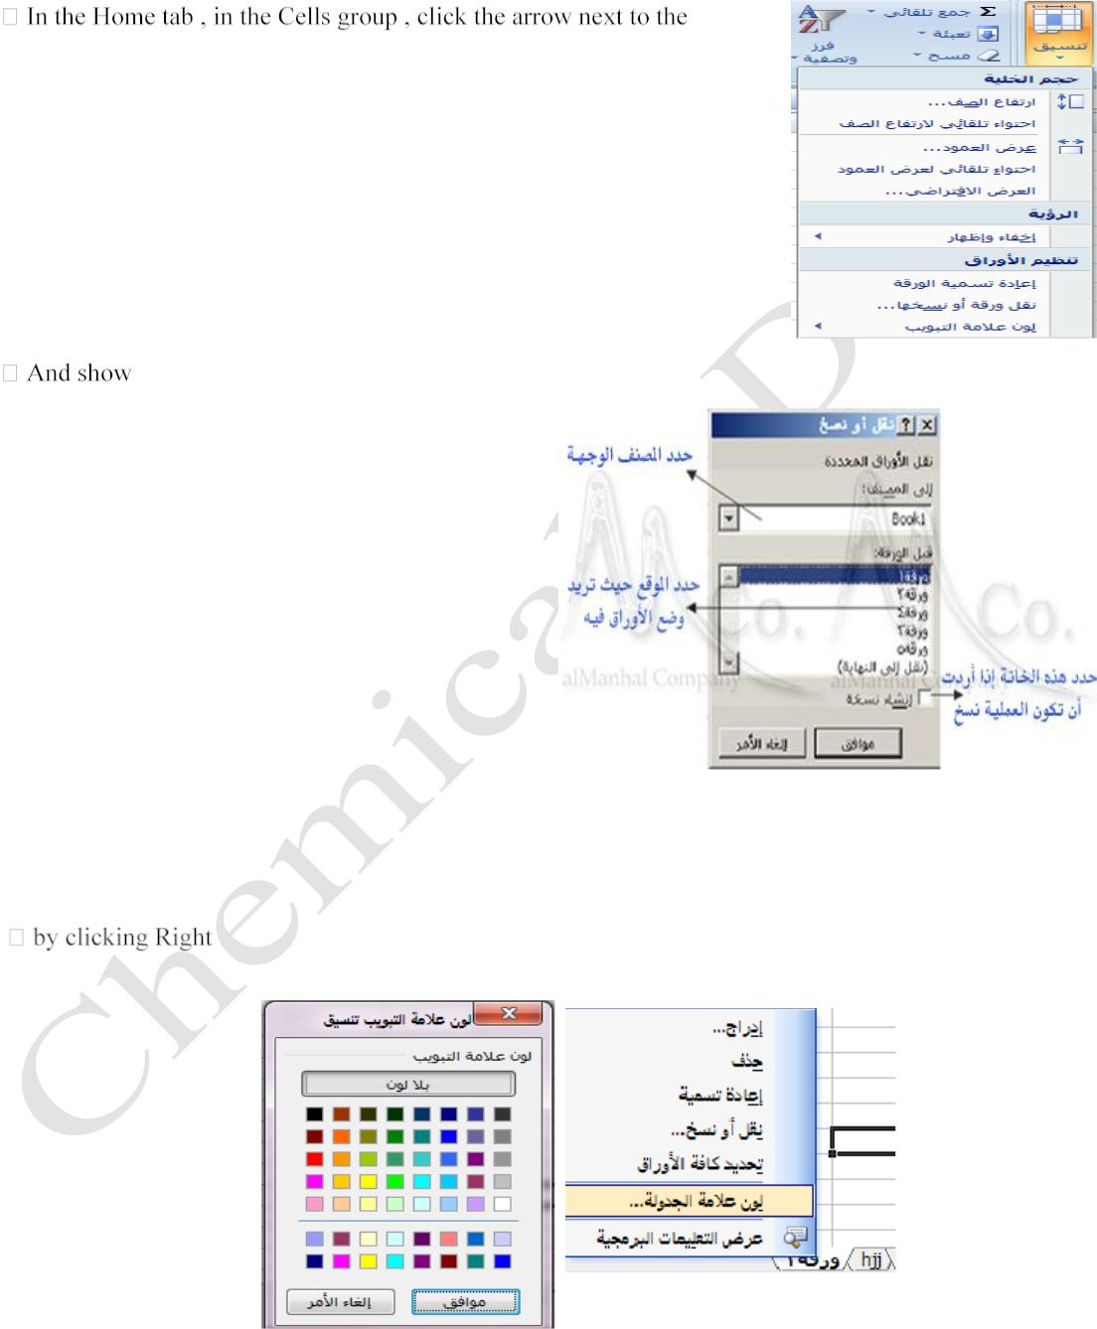
Lecturer
Omar A. Imran
2019 - 2020
Microsoft office Excel 2007
Diyala university/College of Engineering
Department of Chemical Engineering
Second: -
Third: -
we choose from the other papers .
formats , then click Organize paper , and then click Rename. As in Fig .
a dialog box as shown in Figure below.
Trail Version
Trail Version
Trail Version
Trail Version
Trail Version
Trail Version
Trail Version
Trail Version
Trail Version
Trail Version
Trail Version
Trail Version
Trail Version
2. Command (the color of the tab)
Through which you can change the color of the worksheet tab is done to one of the following ways: -
-click the sheet tab and then click the color tab. Click the color you want, and then
click OK. As shown in the figure below
First Class
15

